Slide 1
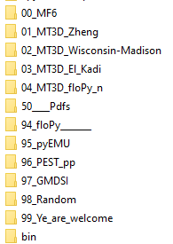
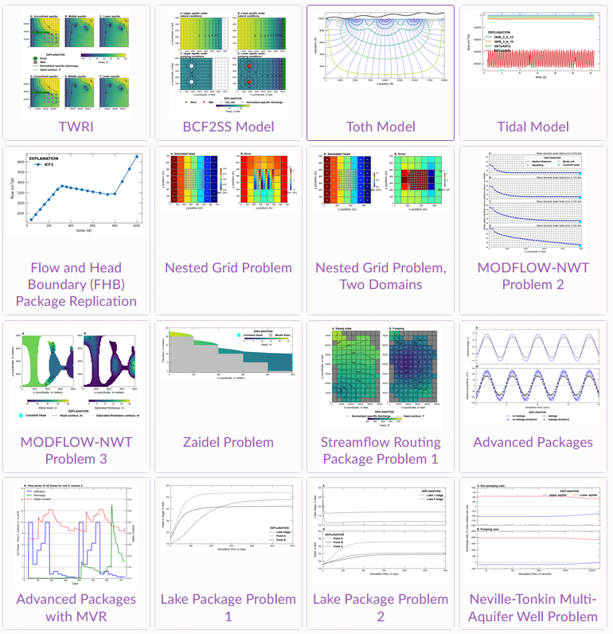
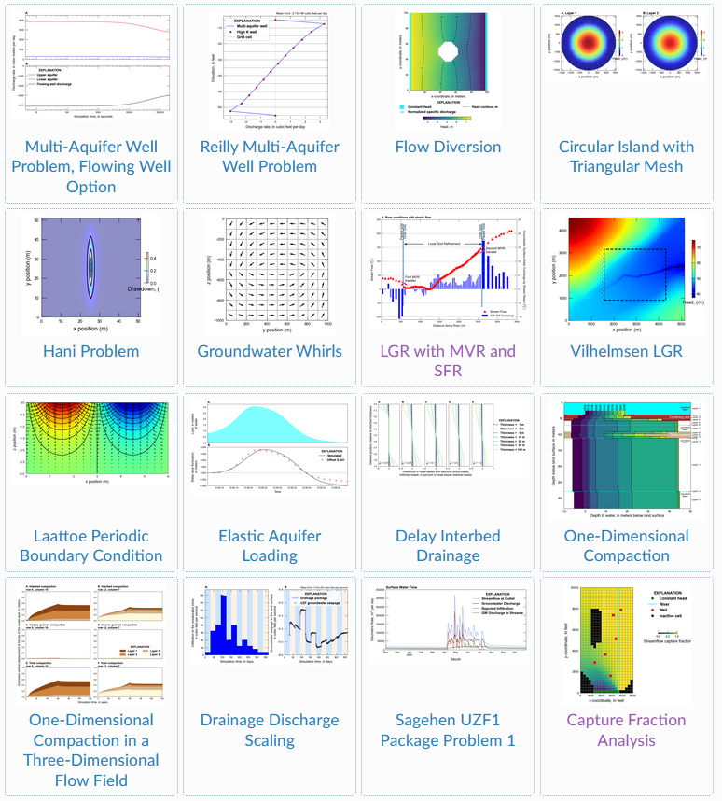
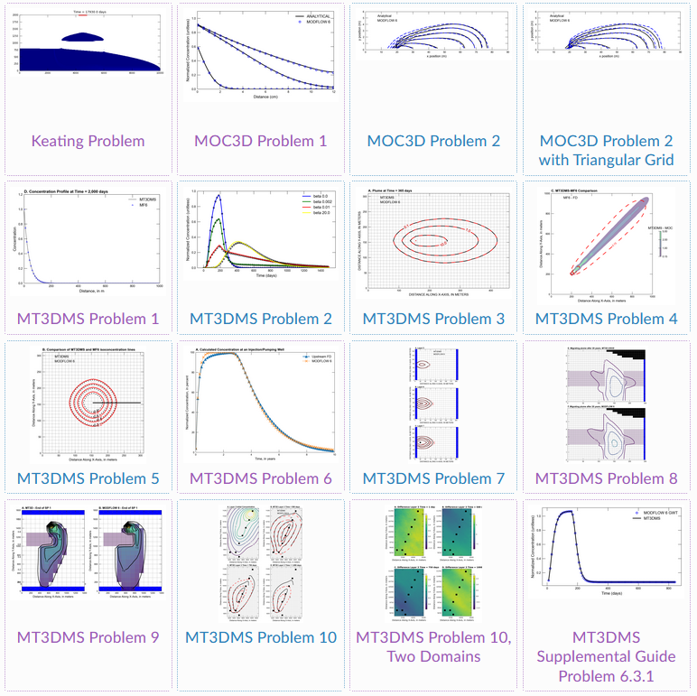
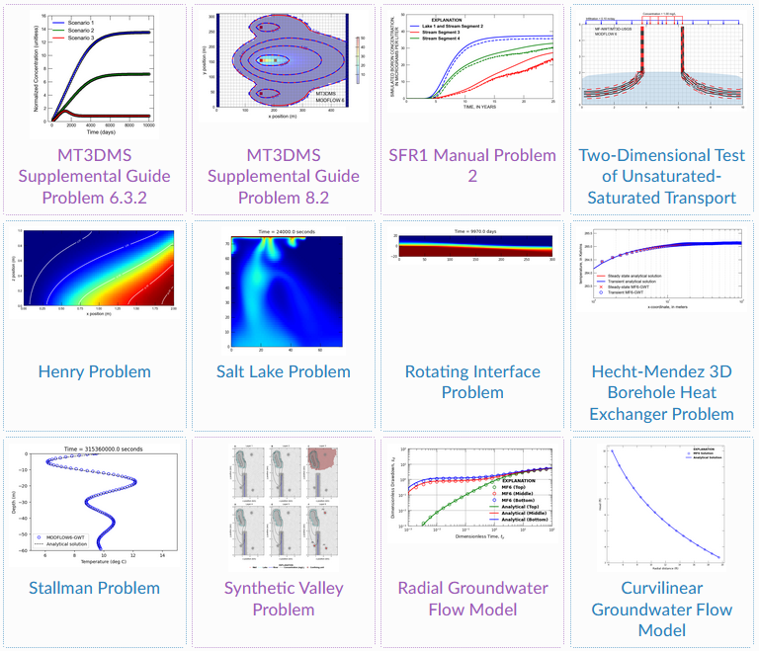
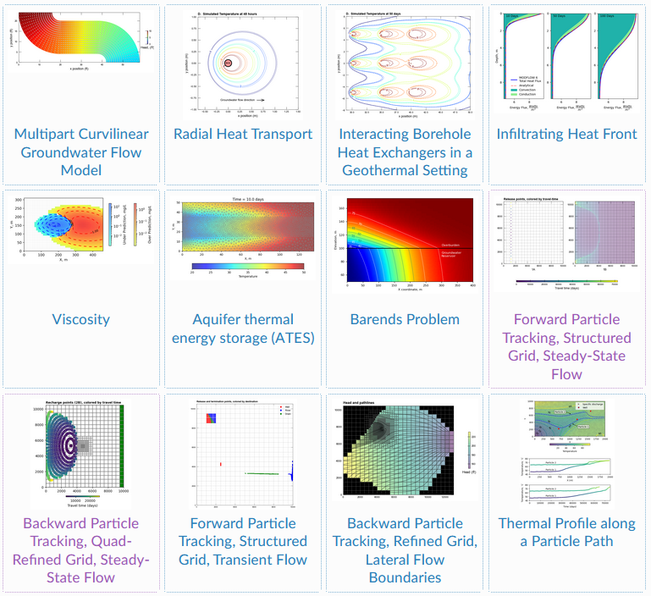
04
20
NWT
LGR
16
32
52
36
64
60
48
72

Slide 2
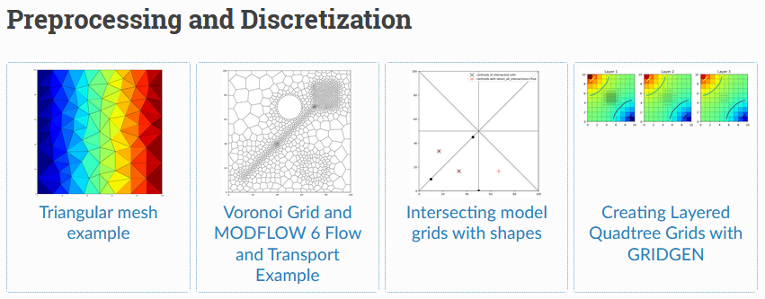
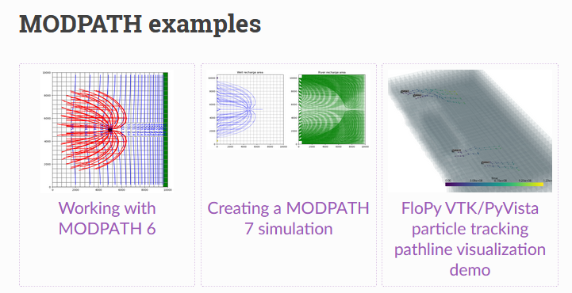
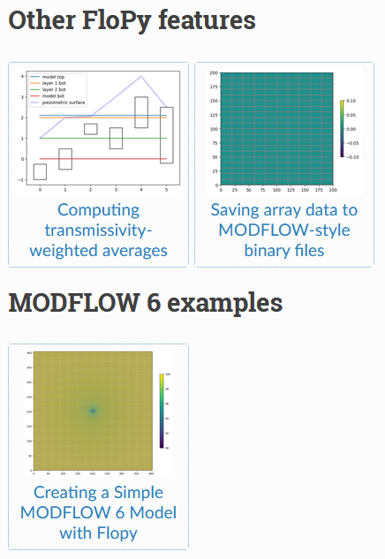
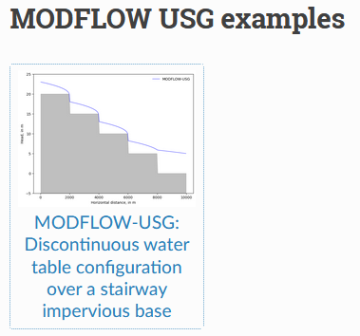
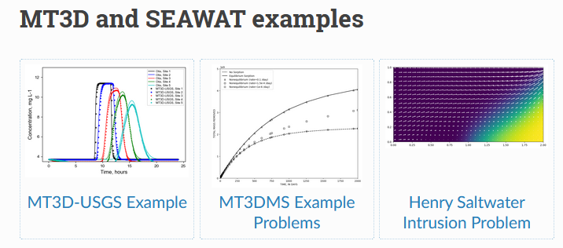
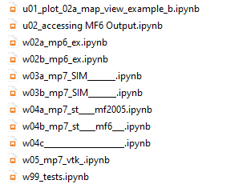
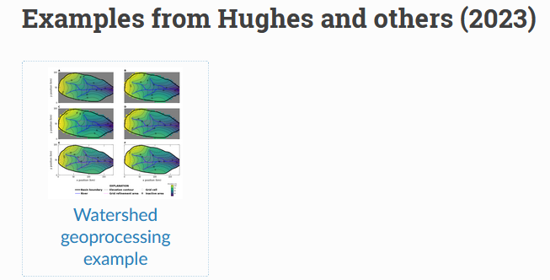
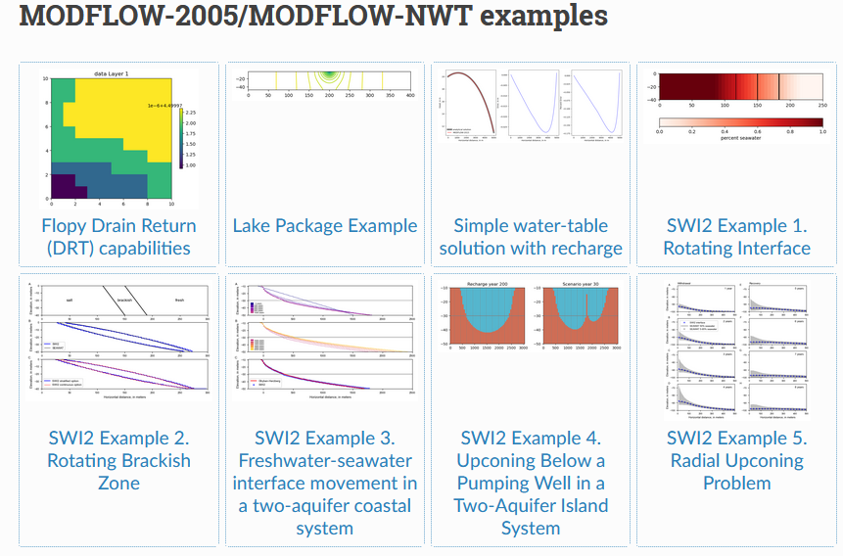
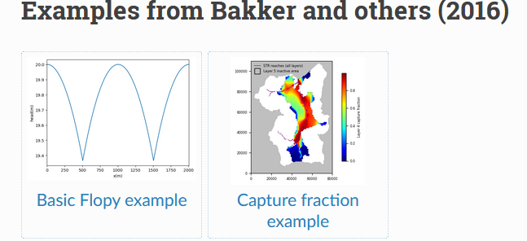

Slide 3
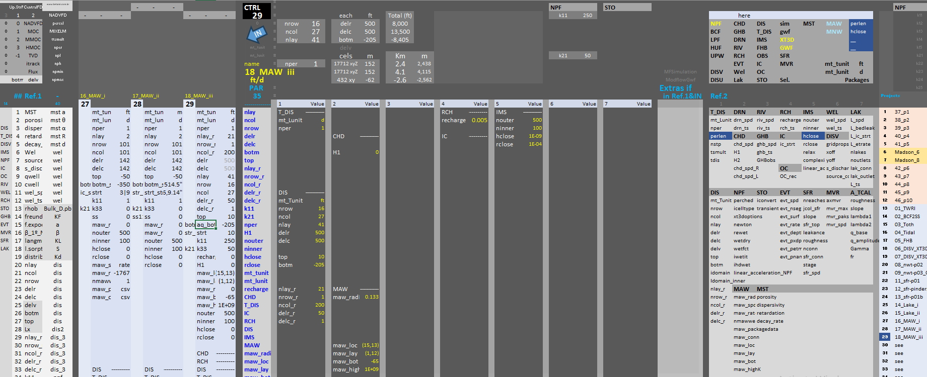
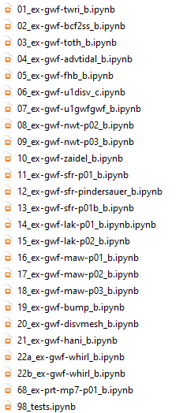
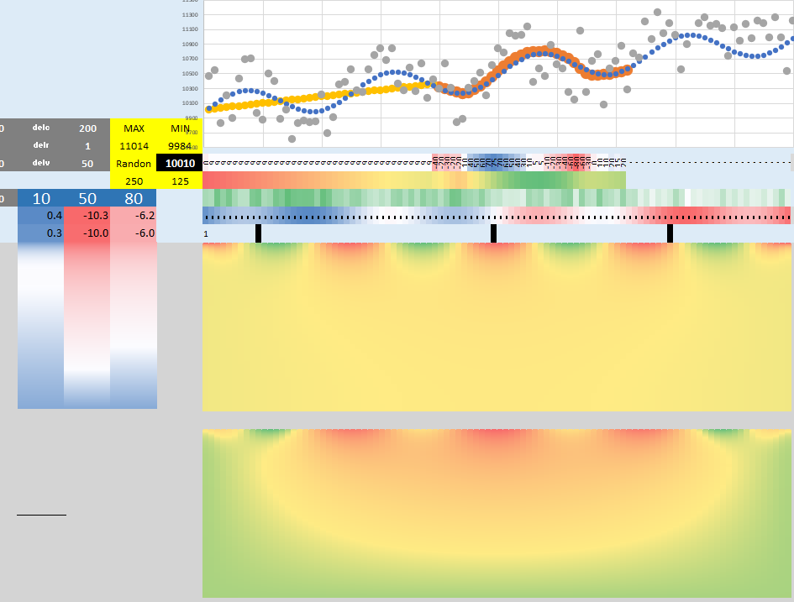
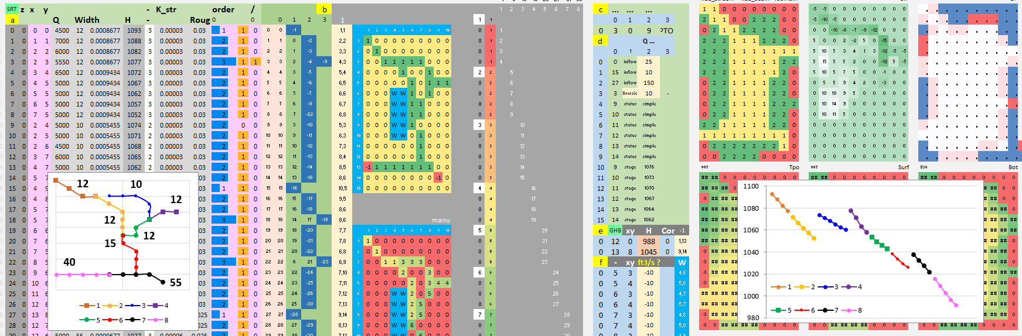
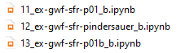
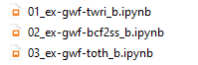
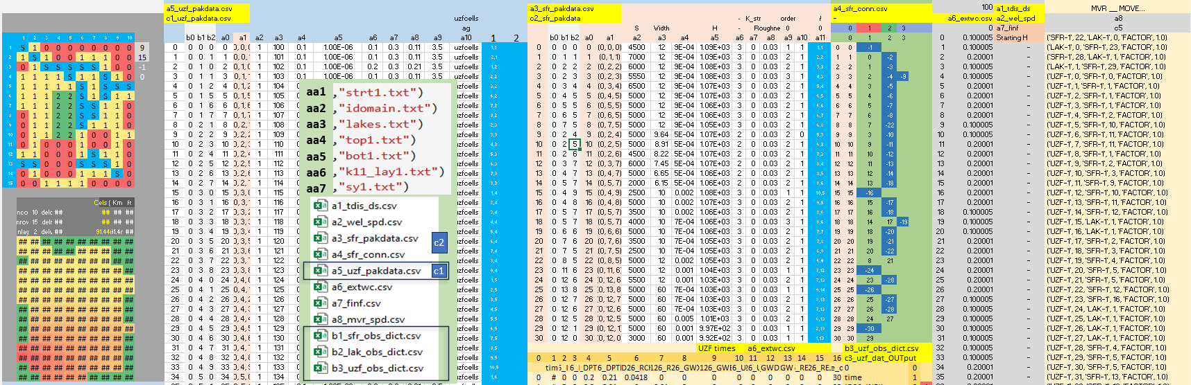
https://github.com/grossiRM/00_Betami/blob/main/99_Ye_are_Welcome/99_xls/01_Summary.xlsx
Excel_01
Excel_02
Toth’s
https://github.com/grossiRM/00_Betami/blob/main/00_MF6/99_Summary_MF6_.xlsx

Slide 4
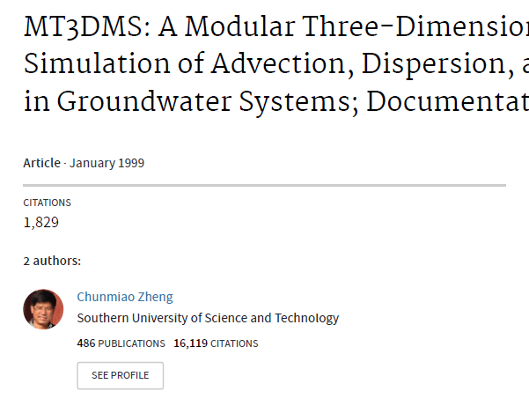
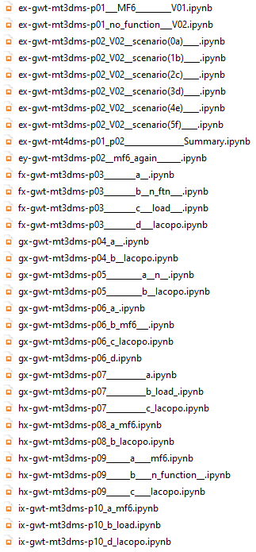
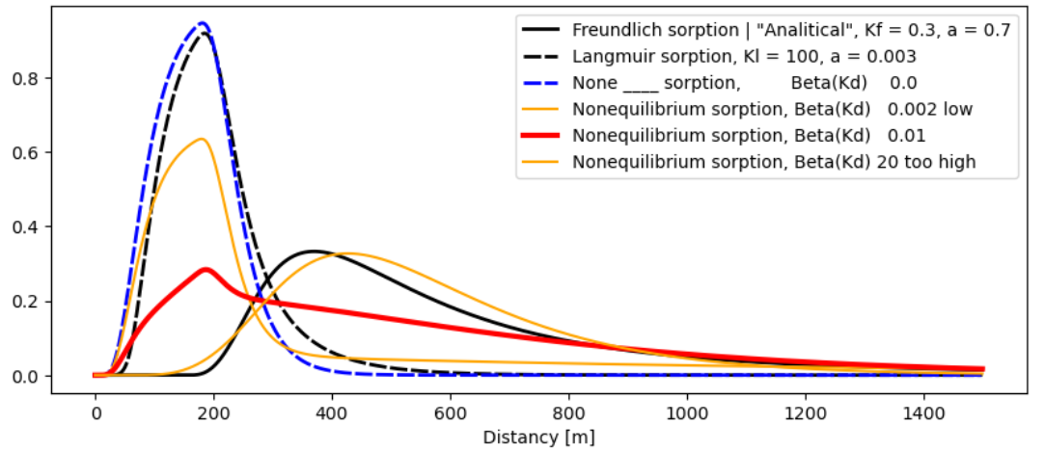
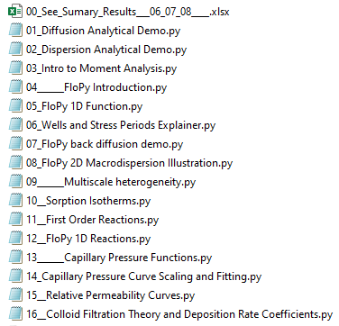
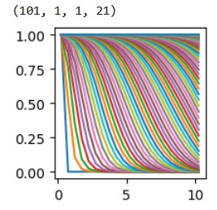
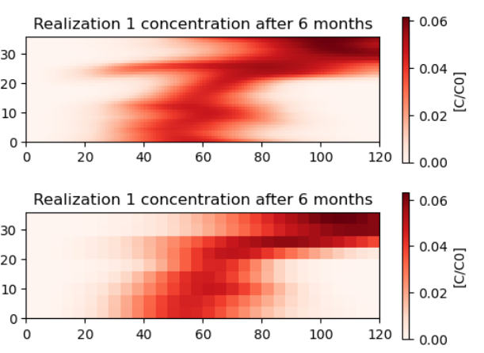
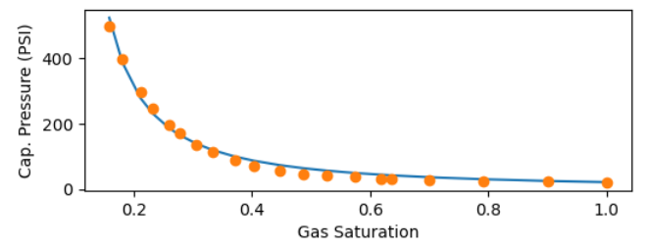
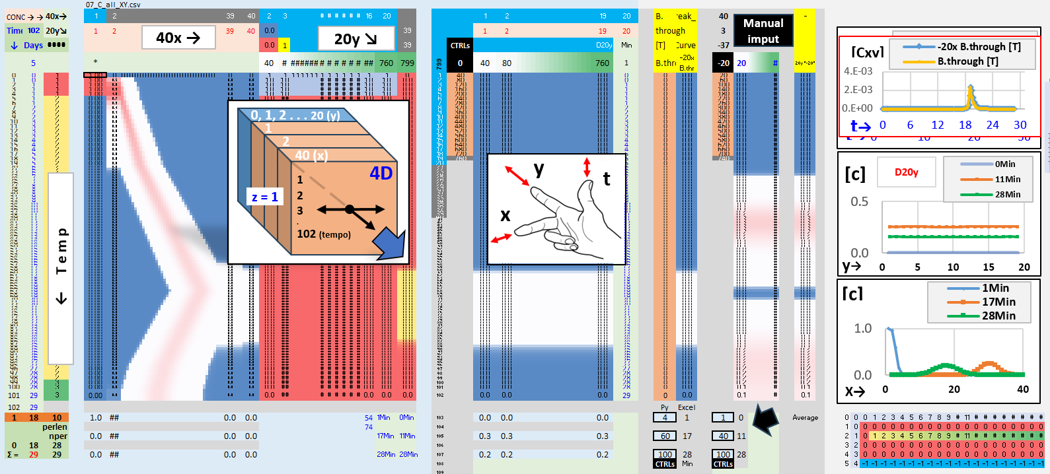
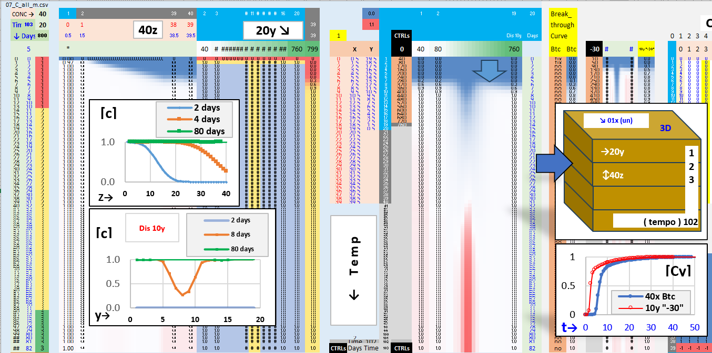
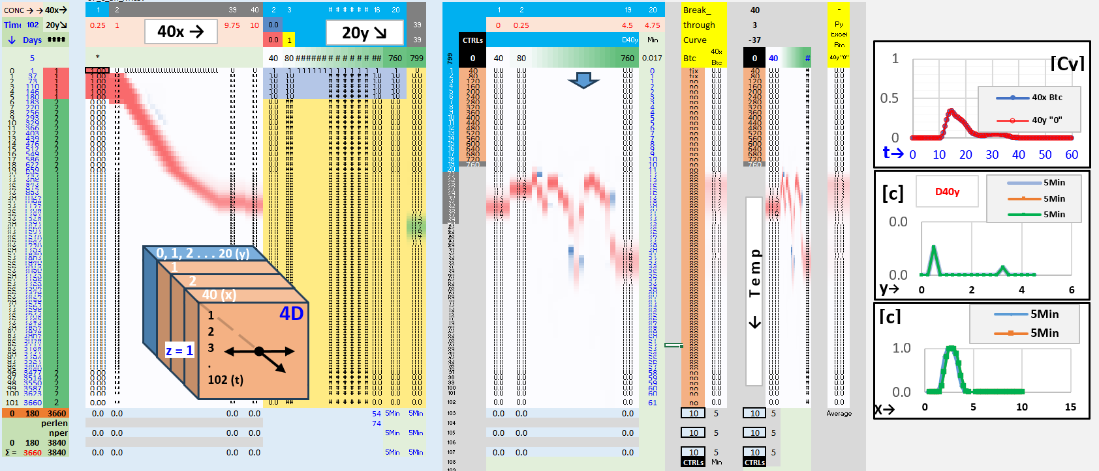
Zheng
Zahasky
1D
2D
Freundlich, Langmuir, decay, R,
.. Flopy isotherms
van Genuchten,
Brooks Corey
Hydro's
Relative Permeability from Capillary Pressure

Slide 5
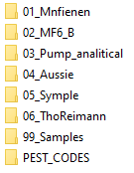
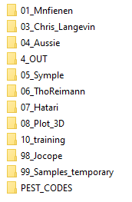
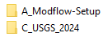
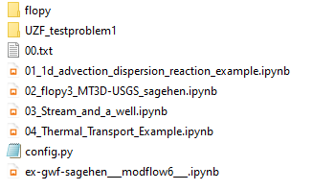
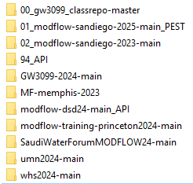
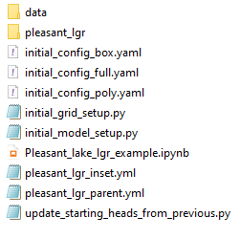
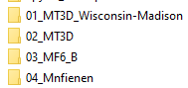
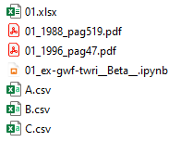
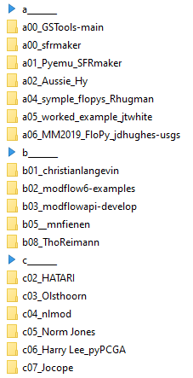
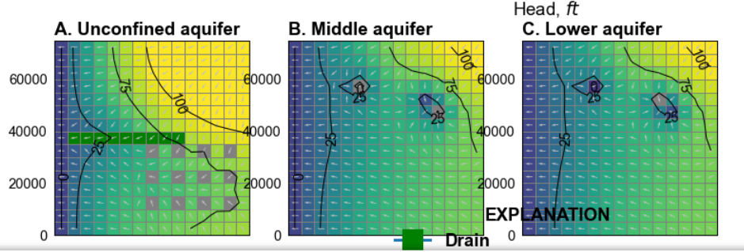
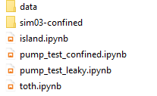
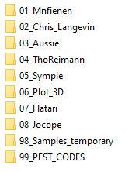
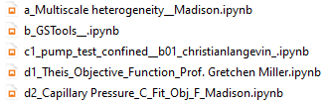
visible
E:\15_REPOS\b01_christianlangevin\00_gw3099_classrepo-master\exercises\MT3DUSGS
E:\15_REPOS\b01_christianlangevin\umn2024-main\notebook
git env! mfsetup kernel
MT3D_Unconfined
https://doi-usgs.github.io/modflow-setup/latest/notebooks/Pleasant_lake_lgr_example.html
offscreen
E:\15_REPOS\00_BETAMI\98_Random\01_Mnfienen\A_Modflow-Setup\examples
E:\15_REPOS\00_BETAMI\98_Random\06_ThoReimann
E:\15_REPOS\00_BETAMI\98_Random\07_Hatari
E:\15_REPOS\00_BETAMI\98_Random\99_Samples_high_L_temp

Slide 6
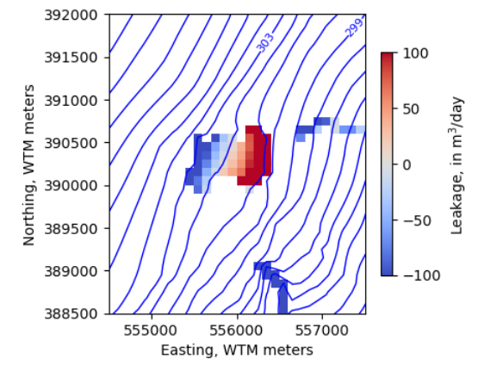
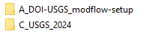
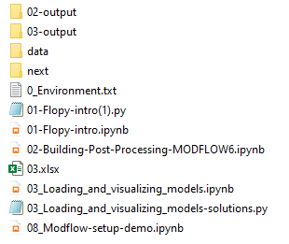
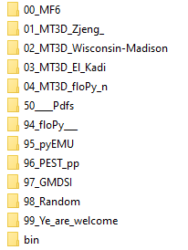
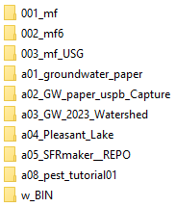










pleasant-lake
… ongoing
… extra: neversink _ PEST workflow

Slide 7





NEXT
Reilly
Problem
Horizontal MNW2
& MT3D
NWT
01
1d_advection_dispersion_reaction_example.ipynb
02
https://modflow6-examples.readthedocs.io/en/latest/_examples/ex-gwf-maw-p03.html
SFR Package
Multi-Node Well (MNW2) Package
01_MNW2_Reilly_Problem.pdf
GSFLOW: Coupled Groundwater and Surface-Water Flow Model
ArcPy
Application Programming Interface - API
03_UZF1_Sagehen _ unconfined _MF2005.pdf

Slide 8


ECOSYSTEM
Teachable
Documented
Reliable
Robust
Efficient
Extensible
Portable
API
SFR
MNW2
MVR packages
christianlangevin

